Slide 1


Contents
What Is CASE Tools Components Of CASE Tools Layers Of CASE Tools Categories Of CASE Tools Perspective Of CASE Tools Benefits Of CASE Tools Problems Of CASE Tools
Components Of CASE Tools

Slide 2
(CASE)
COMPUTER AIDED SYSTEMS ENGINEERING
CASE is a term covering a whole range of tools and methods that SUPPORT SOFTWARE SYSTEM DEVELOPMENT.
CASE tools are programs (software) that automate or support one or more phases of a systems development life cycle.
A collection of tools used to support the software development process. In other words,
Software that is used to support software process activities .
Provides software process support by
automating some process activities
providing information about the software being developed
Currently used in every phase/workflow of life cycle

Slide 3
Two types of tools used by software engineers:
1. Analytical tools
–
Stepwise refinement Cost-benefit analysis Software metrics
–
–
2. CASE tools

Slide 4
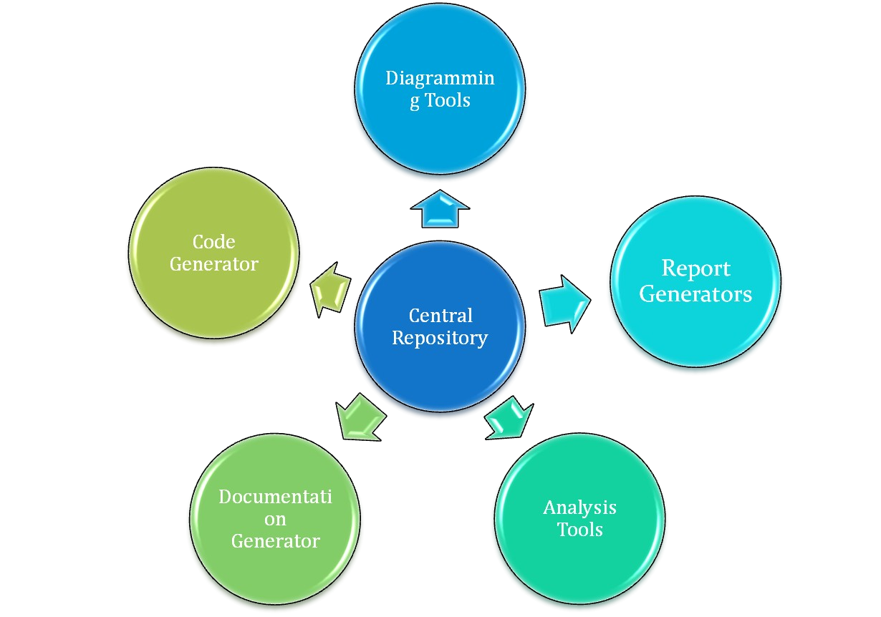
Components Of CASE Tools

Slide 5
Components Of CASE Too l s
1. Central Repository
¬
¬
Centralized Database.
Used to store Graphical Diagrams & Prototype Forms and Reports of analysis and diagramming workflow
Act as
¬
¬
¬
Information Repository Data Dictionary

Slide 6
Components Of CASE Too l s
Report Generator
Used to
Create, modify and test prototypes of computer displays and reports.
Identify which data items to display or collect for each screen or report

Slide 7
Components Of CASE Too l s
Diagramming Tool
Allow you to represent a system and its components visually.
Allows higher level processes to be easily decomposed.
Can examine processes or data models at high or low level.

Slide 8
Components Of CASE Too l s
Analysis tools
¬Generate reports that help identify possible inconsistencies, redundancies and omissions(if any excluded or not).
¬Generally focus on
diagram completeness and consistency.
data structures and usage.

Slide 9
Components Of CASE Too l s
Documentation Tool
Create standard reports based on contents of repository.
Need textual descriptions of needs, solutions, trade-offs, diagrams of data and processes, prototype forms and reports, program specifications and user documentation.
High-quality documentation leads to 80% reduction in system maintenance effort in comparison to average quality documentation.

Slide 10
Components Of CASE Too l s
Code Generation Tool
Create code for the custom feature in object model.
Code Generation Tool helps in:
Connect to the Repository.
Select the Object Model.
Select the custom features to generate code for.
Define properties for each custom feature.
Specify the output of the project.

Slide 11
Layers Of CASE Tools
Upper CASE Tools
Lower CASE Tools Integrated CASE Tools
Cross life cycle CASE

Slide 12
CASE Tools
The application of a set of tools and methods to a software system with the desired end result of high-quality, defect-free, and maintainable software products.
Purpose of CASE Tools
To make it simpler to enact a single design philosophy with the goal to speed up the development process.
To automate mundane(similar) tasks.
To promote a central location for referencing system development activities and documents.
To get accuracy and increase the speed of the tasks.
12

Slide 13
USES:
1. Increasing costs of software development due to
the extreme intensive labor required.
2. Avoid simple human errors in software
development.
3. CASE offers an important opportunity to alleviate(serve) the problems of application development and maintenance.

Slide 14
COMPONENTS OF CASE
TOOLS
A CASE environment contains a collection of tools. Not all environments provide all tools.
Upper CASE
Lower CASE
i-CASE

Slide 15
TYPES OF CASE TOOLS
Upper-CASE:-
Upper CASE is focused in supporting
project identification and selection,
project initiation,
project planning,
analysis and
design.
Describes tools that automate or support the ‘upper’ or earliest phases of systems development.

Slide 16
Supports Software Development activities implementation
Focuses on Analysis Phase
Diagramming Tools
Report Generator
Analysis Tool

Slide 17
Lower-CASE:-
Lower CASE provides support for the
implementation and
maintenance phases.
Describes tools that automate or support the ‘lower’ or later phases of systems development.
Supports Programming and Integration tasks.
Focuses on
Central Repository
Code Generator
Configuration Management

Slide 18
I-CASE (integrative case):-
support the entire SDLC.
Supports both Upper CASE Tools and Lower CASE Tools.
Focuses on Analysis Code Design Database

Slide 19



Categories Of CASE Tools

Slide 20
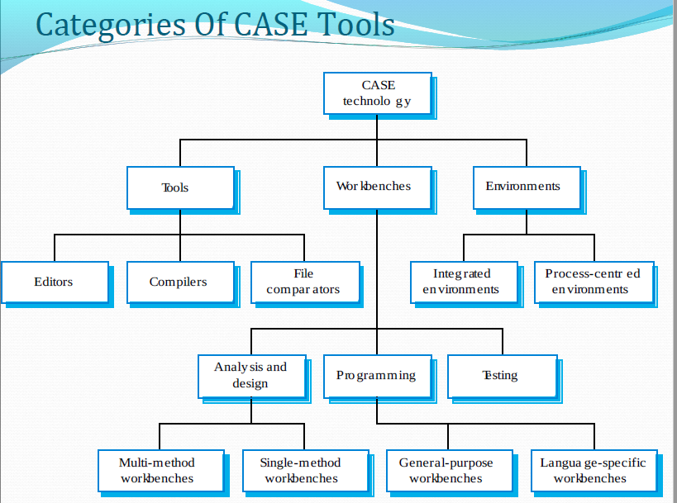

Slide 21
Perspective Of CASE Tools
Three Perspective
Functional perspective
Tools are classified according to their specific function.
Process perspective
Tools are classified according to process activities that are supported.
Integration perspective
Tools are classified according to their organisation into integrated units.

Slide 22
Benefit Of CASE Tools
Improve software quality
Enforce discipline
Help communication between development team members
Information is illustrated through diagrams that are typically easier to understand
Development information is centralized

Slide 23
Reduction of time and effort
Tasks are much faster to complete and alter
Enhance reuse of models or models’ components
Can reduce maintenance costs

Slide 24
*Problems Of CASE Tools
Limitations in flexibility of documentation
Major danger: completeness and syntactic correctness does NOT mean compliance with requirements
Costs associated with the use of the tool
Purchase price
Training

Slide 25
CASE Usage Within the SDLC
SDLC Phase Key Activities CASE Tool Usage
Project identification and selection
Display and structure high-level organizational information
Diagramming and matrix
tools to create and
structure information
Project initiation and planning
Develop project scope and feasibility
Repository documentation
and
generators to develop project plans
Analysis
Determine and structure system requirements
Diagramming to create
process, logic and data models

Slide 26
CASE Tool Usage
SDLC Phase
Key Activities
Design
Create new system designs
Form and report generators
to prototype designs;
analysis and documentation generators to define specifications
Implementatio n
Translate designs into an information system
Code
generators
and form and report
analyzers,
generators; documentation generators to develop system and user documentation
Maintenance
Evolve information systems
All tools are used .

Slide 27
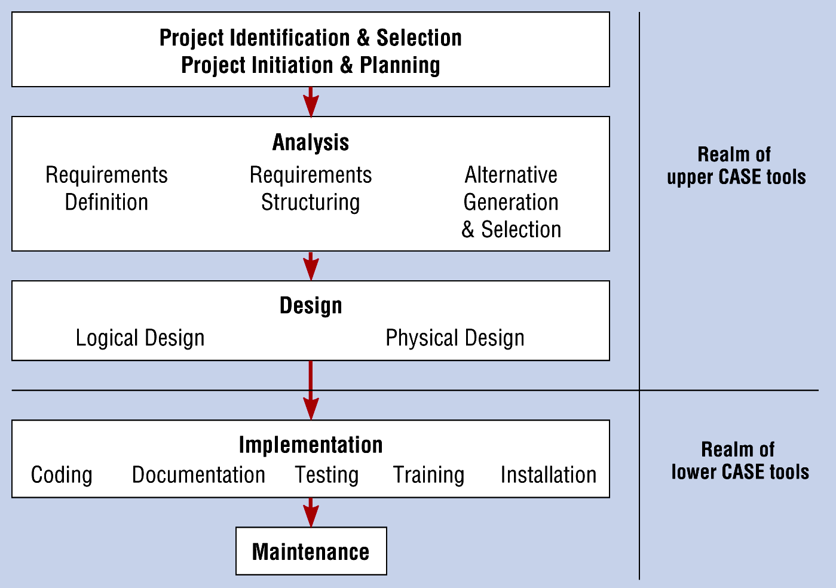
CASE and the SD LC

Slide 28
Types of CASE Tools
Programming tools.
Documentation tools.
Static analysis tools.
Metrics management tools.
Quality assurance tools.
Diagramming tools.
Requirement tracing tools.
Programming tools.
Process modelling and management tools.
Prototyping tools.
Software configuration management tools.

Slide 29
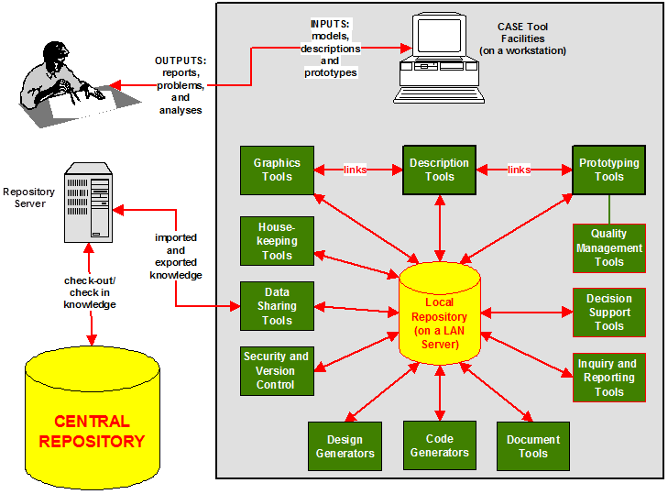
CASE Tool Components

Slide 30
Advantages of CASE Tools
Increased speed
Increased accuracy
Reduced life time maintenance
Better documentation
Programming in the handofprogrammers
Intangible benefits

Slide 31
Disadvantages of CASE Tools
May be difficult to customize
Requires training of maintenance staff
May be difficult to use with existing systems
Requires more extensive and accurate definition of us requirement.
It is costly if it is proprietary tool.

Slide 32
The Good and Bad about CASE
Development process productivity and quality increases are realizable
Portability of new systems to other platforms is greatly enhanced
Analyst skill set will improve due to greater understanding of the process
Time to delivery of new applications will decrease
Conformity to development standards will increase
CASE acquisition costs are extremely high
Training of analysts and administrators is costly and time-consuming
Most organizations do not have clear standards for application development
CASE tools can be viewed as a threat to job security
CASE tools do not have a great reputation due to early benefits not being realized

Slide 33




Slide 34
Introduction
Process of creating a data model for an information system by applying formal data modeling techniques.
Process used to define and analyze data requirements needed to support the business processes.
Therefore, the process of data modeling involves professional data modelers working closely with business stakeholders, as well as potential users of the information system.

Slide 35
What is Data Model
Data Model is a collection of conceptual tools for describing data, data relationships, data semantics and consistency constraint.
A data model is a conceptual representation of data structures required for data base and is very powerful in expressing and communicating the business requirements
A data model visually represents the nature of data, business rules governing the data, and how it will be organized in the database

Slide 36
A data model provides a way to describe the design of a database at the physical, logical and view levels.
There are three different types of data models produced while progressing from requirements to the actual database to be used for the information system

Slide 37
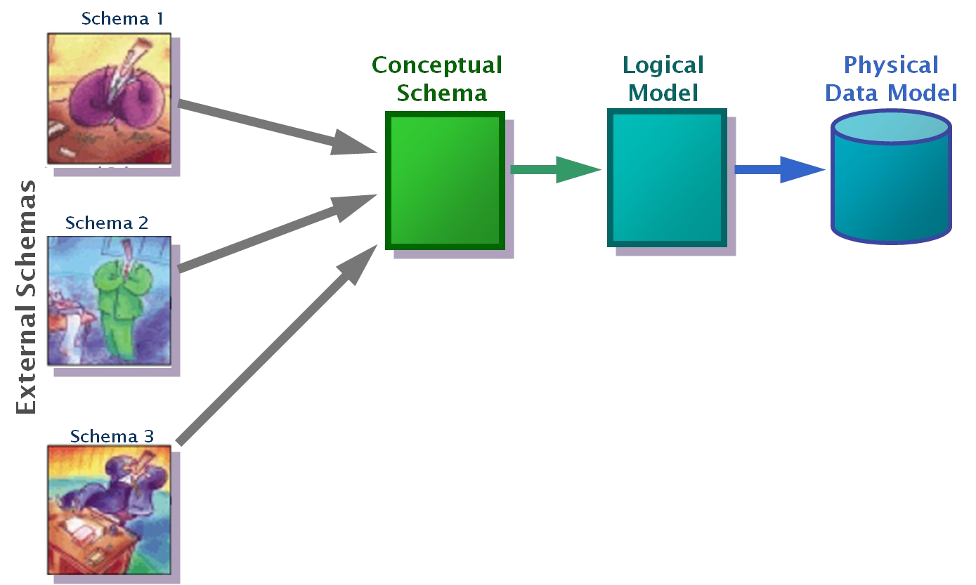
Different Data Models
Conceptual: describes WHAT the system contains
Logical: describes HOW the system will be implemented, regardless of the DBMS
Physical: describes HOW the system will be implemented using a specific DBMS

Slide 38
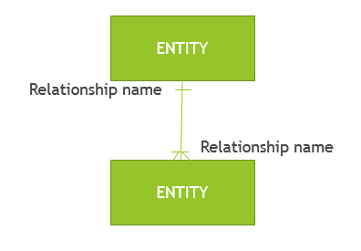
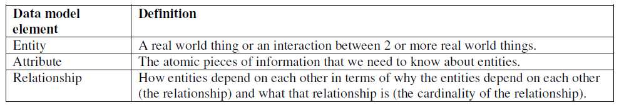
A data model consists of entities related to each other on a diagram:

Slide 39
Example: Given that …
“Customer” is an entity.
“Product” is an entity.
For a “Customer”, we need to know their
“customer number” attribute and
“name” attribute.
For a “Product”, we need to know their
“product name” attribute and
“price” attribute.
“Sale” is an entity that is used to record the interaction of “Customer” and “Product”.

Slide 40
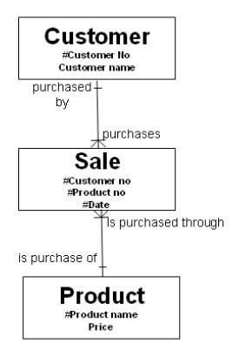
Here is the diagram that encapsulates these rules:

Slide 41
Notes
By convention, entities are named in the singular.
The attributes of “Customer” are “Customer No” (which is the unique identifier or primary key of the “Customer” entity and is shown by the # symbol) and “Customer Name”.
“Sale” has a composite primary key made up of the primary key of “Customer”, the primary key of “Product” and the date of the sale.
Think of entities as tables, think of attributes as columns on the table and think of instances as rows on that table:

Slide 42
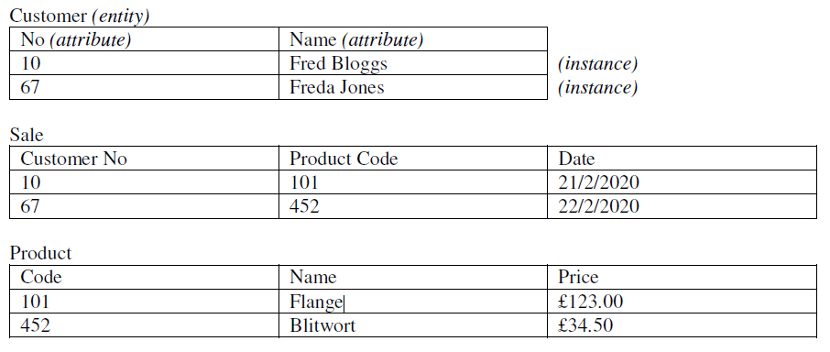
•
If we want to know the price of a Sale, we can ‘find’ it by using the “Product Code” on the instance of “Sale” we are interested in and look up the corresponding “Price” on the “Product” entity with the matching “Product Code”.

Slide 43
Types of Data Models
Entity-Relationship (E-R) Models
UML (unified modeling language)

Slide 44
Entity-Relationship Model
Entity Relationship Diagrams (ERD) as this is the most widely used
ERDs have an advantage in that they are capable of being normalized
Entity
Primary key
Attributes
Represent entities as rectangles
List attributes within the rectangle

Slide 45
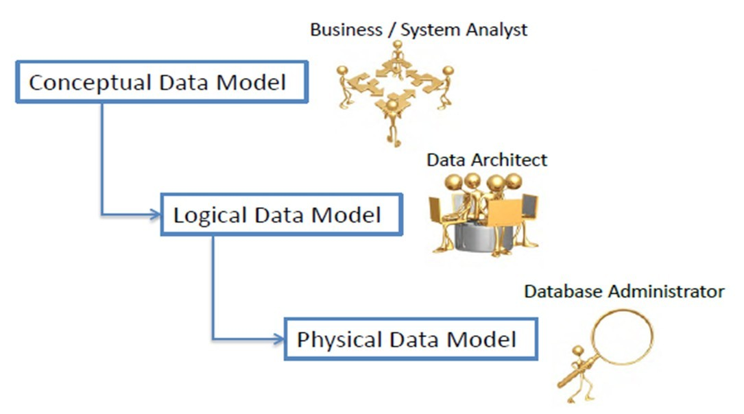
Why and When
The purpose of a data model is to describe the concepts relevant to a domain, the relationships between those concepts, and information associated with them

Slide 46
Used to model data in a standard, consistent, predictable manner in order to manage it as a resource.
To have a clear picture of the base data that your business needs
To identify missing and redundant base data

Slide 47
To Establish a baseline for communication across functional boundaries within your organization
Provides a basis for defining business rules
Makes it cheaper, easier, and faster to upgrade your IT solutions

Slide 48
Role of CASE in Conceptual Data Modelling
Two functions:
Maintaining ER diagrams as visual depiction of structured data requirements
Linking objects on ER diagrams to corresponding descriptions in a repository.
Note: Most CASE tools supports 1 or more ER diagramming notations where as many tools do not supports drawing higher relationships like ternary.
So several binary relationships are used though this is not semantically correct.

Slide 50
CASE Summary
Overall use of CASE tools on a software system improves software quality dramatically by –
Reducing errors
Improving designs throughout the development
Standardizing many tasks and development aspects
Providing many many well-tested automated functions
Centralizing resources
CASE is so good for software development its extremely rare to find a program that doesn’t include some form of it within the last 2 decades

